Slide 1
Evaluation of Style Advisor Performance
Comprehensive Analysis and Insights

Slide 2
Introduction & Objectives
Overview of the project :
The project aims to evaluate the performance of Style Advisors using a comprehensive set of criteria. The evaluation data covers various aspects such as store ambiance, first impressions, discovery of customer needs, trial experience, and overall customer service. The primary focus is on understanding how well Style Advisors are performing and identifying areas for improvement.
Objectives of the analysis
Performance Grading: Assign grades to each Style Advisor based on their Evaluation_Score.
Pivot Table Analysis: Analyze average evaluation scores by zone to understand regional performance.
High Performer Identification: Determine which region has the highest percentage of high performers.
Visualization: Create visual representations of the data to highlight key trends and insights.
Presentation Report: Summarize findings and provide recommendations for management.

Slide 3
Data Overview
Explanation of columns and data structure
Core Data Fields
Column Name | Description
Evaluation_ID | Unique identifier for each evaluation entry.
Evaluation_Date | Date when the evaluation took place.
Evaluation_Score | The total or overall score (numeric) assigned to that visit — typically from 0–100.
GRADE | Performance category derived from Evaluation_Score, e.g. “High Performer”, “Average Performer”, “Low Performer”, “Bottom Performer”.
Scoring Categories (Quantitative Metrics)
Column | Meaning
STORE AMBIANCE | Rating of store cleanliness, lighting, and general appearance.
FIRST IMPRESSIONS | How welcoming and engaging the staff were when the customer entered.
DISCOVERY | How well the Style Advisor understood customer needs and preferences.
RECOMMENDATIONS | Whether the advisor recommended appropriate products.
TRIAL EXPERIENCE & UPSELL | How well the advisor managed the product trial and attempted to upsell.
OBJECTION HANDLING | How well objections or concerns were addressed.
CLOSURE & CARE | Quality of closing interaction and post-sale care.
OVERALL EXPERIENCE | Summary score for the overall customer journey.
Location & Regional Fields
Column | Description
Location_City | City where the evaluated store is located.
Location_State | State or region name.
Zone | Geographic zone (e.g. North, South, East, West). Useful for regional comparisons.
Avg Score per zone | (Likely derived or blank) — may represent pre-calculated average score for the zone.
Location_Country | Usually “India” (or country where the store operates).
Auditor Demographics
Column | Description
Age of the Auditor | Age of the mystery shopper/auditor.
Gender of Auditor | Gender of the person conducting the audit.
Please describe what you were wearing during your visit. | For identification and audit verification.
Visit Timing
Column | Description
Time of entry: | Entry time into the store.
Time of exit: | Exit time.
Duration of visit: | Calculated time spent in the store.
Staff Information
Column | Description
Name of the Style Advisor who attended to you: | Staff member’s name.
Physical description columns | Detailed physical description of the staff for verification (e.g. appearance, attire).
Detailed Question Sections
Theme | Example Questions
Store Ambiance | Cleanliness, signage, lighting, merchandise display.
First Impressions | Greeting, wait time, temperature, aroma, comfort.
Discovery | Did the advisor understand customer needs?
Product Presentation | Did the advisor describe benefits, craftsmanship, brand story?
Trial Experience & Recommendations | Did the advisor offer trials, compliments, cleaning, up-sell?
Objection Handling | How objections or concerns were managed.
Closure & Follow-up | Did the advisor mention loyalty programs, offers, say thank you, accompany to exit?
Customer Satisfaction | Ratings (1–10) for likelihood to return and overall assistance.

Slide 4
Performance Grading
High Performer: 90% - 100%
Average Performer: 70% - 89%
Low Performer: 50% - 69%
Bottom Performer: Below 50%
The performance has been graded based on the above metrics.
Below are the zone wise performance of the Advisors:
Zones | Average Performer | Bottom Performer | High Performer | Low Performer
East | 1.00 | 1.00 | 2.00 | 3.00
North | 9.00 | 1.00 | 4.00 | 5.00
South | 7.00 | 3.00 | 2.00 | 6.00
West | 10.00 | 3.00 | 2.00 | 2.00
Grand Total | 27.00 | 8.00 | 10.00 | 16.00

Slide 5
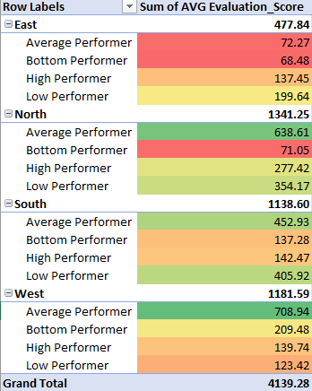
Pivot Table Analysis
Here we see an average of Evaluation Score by Zone:
The analysis of average evaluation scores reveals clear performance distinctions across regions:
North leads with the highest aggregate score, driven significantly by strong results from average and low performers.
West closely follows, demonstrating consistent contributions from all categories, with average performers making the largest impact.
South maintains a balanced profile, particularly due to solid performances from low and average performers.
East shows notably lower total scores compared to the other regions, indicating an opportunity for targeted improvement, especially among bottom and average performers.

Slide 6
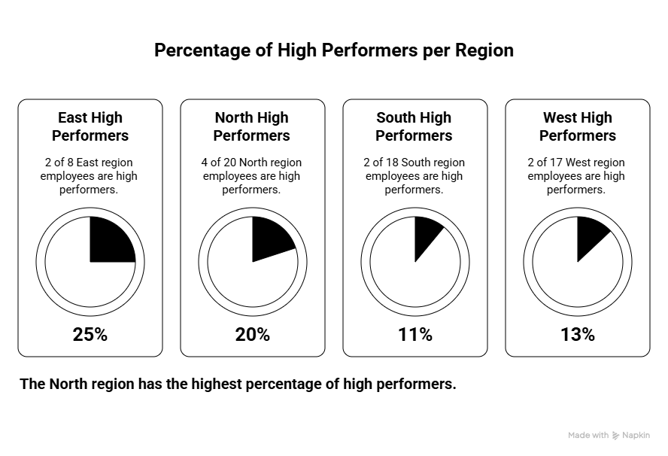
High Performer Analysis
High Performer Distribution
North stands out with 4 high performers, demonstrating a strong concentration of top talent in that region.​
East, South, and West each have 2 high performers, indicating a more evenly distributed presence of top performers outside of North.​
In total, there are 10 high performers across all regions, underscoring the relatively limited—but impactful—group driving exceptional results within the organization.​
This distribution highlights North as a benchmark for developing high performers, while other regions may benefit from focused talent development initiatives aimed at expanding their pool of top achievers.

Slide 7
Average Evaluation Scores by Zone
Average Evaluation score by zone:
Percentage of High Performers by Region

Slide 8
Average Evaluation Scores by Zone
Performance Trends Over Time

Slide 9
Breakdown by Evaluation Criteria
North region excels across almost all metrics, achieving the top score in categories like Store Ambiance (1682), First Impressions (1570), Discovery (1217), and Objection Handling (1459), demonstrating best-in-class customer experiences.​
South and West both show strong, balanced performances with high totals in Store Ambiance, Objection Handling, and Overall Experience, indicating a broad strength in customer interactions.​
East ranks lowest in every metric such as Store Ambiance (615), Closure & Care (363), and Overall Experience (522) highlighting considerable room for improvement and prioritization for support.​
The stark contrast between North’s leadership and East’s lagging results offers a clear directive for organizational focus: replicate top-performing practices regionally and address the root causes limiting East’s effectiveness.

Slide 10
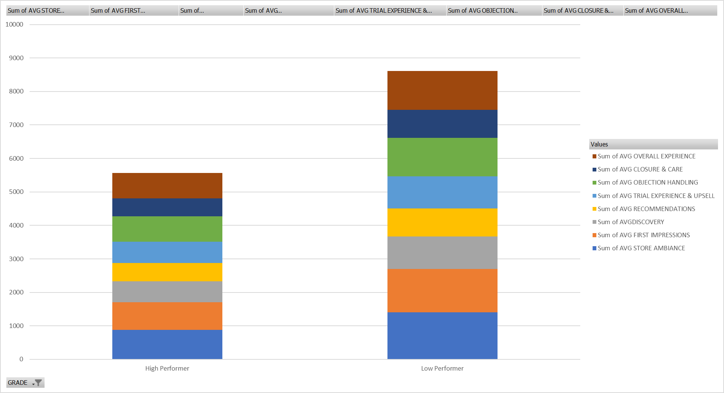
High vs. Low Performers Comparison
This chart provides a comprehensive visual comparison between High Performers and Low Performers across all critical customer experience metrics.​
Clearly, Low Performers have higher aggregate scores in every metric, indicating a larger volume of evaluations but not necessarily higher quality outcomes highlighting where the bulk of customer interactions occur.​
The segmentation of the bars enables stakeholders to pinpoint specific areas such as Store Ambiance, First Impressions, and Objection Handling where targeted coaching and support could drive significant improvements.​
By drawing attention to the distribution and scale of each metric within both groups, this visualization supports strategic prioritization, helping to focus resources where they can deliver the greatest impact on overall performance.

Slide 11
Regional Performance Overview
North: The North region consistently leads in overall evaluation scores, boasting the highest sums in nearly all key customer experience metrics (store ambiance, first impressions, discovery, objection handling, and more). The strong showing is attributed both to high performer concentration and robust contributions from average and low performers. North sets the benchmark for performance company-wide.​
West & South: Both regions deliver strong, balanced results, with notable totals in areas such as store ambiance and overall experience. In West, “Average Performer” makes the largest impact; South displays stable scores, especially from low and average performers.​
East: The East region lags significantly behind all others across metrics, frequently showing the lowest totals in criteria like store ambiance, closure & care, and overall experience. This indicates a clear need for focused support and targeted development to elevate scores in these fundamental areas.

Slide 12
Trends Observed Over Time
Visualizations show consistent leadership by North and West in evaluation scores, with these regions maintaining higher performance steadily across multiple reporting periods.​
While North holds the top spot over time, South and West demonstrate stable and robust results without considerable fluctuation, illustrating ongoing operational discipline.
East’s scores demonstrate persistent underperformance over time, without noticeable upward trends. This stability at a lower level signals deep-rooted challenges rather than short-term anomalies, emphasizing the urgency for intervention.

Slide 13
Performance Distribution Analysis
Grade Segmentation: High performers are relatively few in number (10 overall), with North leading (4 high performers) and other regions (East, South, West) having two each. Most evaluations are clustered among average and low performers, especially for East and South.​
Metric Contribution: Across the company, the largest share of impact comes from “Average Performer” and “Low Performer”. This suggests improvement efforts in these segments could have the greatest effect overall. “Bottom Performer” counts are highest in South and West, presenting clear opportunities for improvement in these locations.​
High vs. Low Performer Insights: Low performers register higher total metric sums likely reflecting a larger number of observations rather than quality of outcomes while high performers, though fewer, contribute disproportionately to best results in certain categories. This highlights the importance of not only expanding the high performer pool, but also raising the median quality among average and low performers.

Slide 14
Recommendations
Suggested Actions
Replicate Best Practices from North: Conduct knowledge-sharing sessions where North region’s top performers can share their strategies, customer engagement techniques, and operational routines with teams from other regions, especially East.​
Targeted Coaching for East: Implement an intensive coaching and mentoring program for Style Advisors in the East region, focusing on bottom and average performers. Analyze gaps in training, resources, or management support and address them proactively.​
Expand High Performer Talent Pool: Facilitate focused development workshops and training for average and low performers, leveraging success stories and skill-building exercises proven effective for high performers in North.​
Data-Driven Performance Tracking: Introduce regular, region-level reviews using granular evaluation criteria (such as store ambiance, first impressions, etc.), allowing ongoing measurement, feedback, and early identification of performance dips.​
Recognize and Reward Improvement: Launch incentive programs celebrating improved scores or successful implementation of new practices, fostering a culture of continual development and motivation across all regions.

Slide 15
Recommendations
Focus Areas for Improvement
East Region Improvement: All major metrics (store ambiance, first impressions, closure & care, overall experience) are significantly lower in East. Prioritize investment in staff training, customer service protocols, and store environment upgrades here.​
Development of Average and Low Performers: Since a large proportion of Style Advisor evaluations fall into average and low categories, strategic upskilling for these groups will yield the greatest overall performance uplift. Focus coaching on customer discovery techniques, objection handling, and closure.​
Closure & Care and Discovery Metrics: Across multiple regions (especially East, South, and West), scores in closure & care and discovery are consistently lower than in other categories. Improving these will directly enhance customer satisfaction and increase repeat business.​
Consistent Performance Reviews: Standardize feedback and evaluation processes across all regions to ensure all Style Advisors receive actionable insights and development opportunities based on their specific performance data.

Slide 16
Conclusion
Recap of Findings, Final Thoughts & Next Steps
Our analysis revealed clear distinction in regional performances with North consistently leading across key metrics such as overall score, customer experience factors, and proportion of high performers, while East lags behind significantly and requires urgent development focus.​
South and West maintain robust results, driven largely by strong contributions from average and low performers, indicating that investing in mid-tier talent can yield widespread improvement.​
Trends over time show persistent strength for North and stable performance in West and South, but highlight entrenched challenges in East with no upward trajectory, emphasizing the need for strategic intervention.​
High performers comprise a small but impactful segment, and most Style Advisors fall in average or low performer categories signaling substantial opportunity for improvement through targeted training and ongoing support.​
Going forward, the priority is to replicate North’s best practices region-wide, concentrating support and resources where scores are lowest (especially East), and nurturing the development of average and low performers through coaching, standardized feedback mechanisms, and incentive programs.​
By following these actions, leadership can ensure consistent, data-driven improvements, set clear accountability, and create a culture where top performance is both recognized and achievable for all.

Slide 17
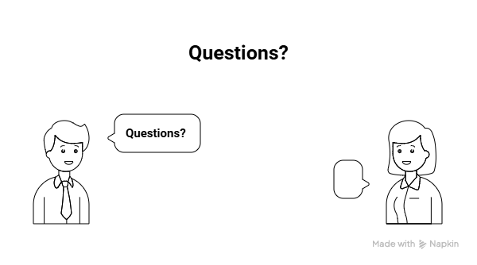
Q&A

